Slide 1


Predictive Maintenance Using Machine Telemetry Data
This project focuses on developing a predictive maintenance system using machine telemetry data to forecast equipment failures in manufacturing environments. The goal is to enable proactive maintenance, thereby reducing downtime and maintenance costs. By utilizing data from voltage, rotation, pressure, and vibration sensors, along with error logs, failure records, and maintenance history, the system aims to predict when equipment will fail and schedule maintenance tasks ahead of potential failures.
by Luca Bigoni

Slide 2

Implementation
Real-Time Monitoring
Deploy the model to continuously monitor machinery in real-time, processing incoming telemetry data to predict potential failures.
Alert System
Develop an automated alert system to notify technicians of predicted failures, allowing for timely intervention.
Integration
Integrate the predictive maintenance system with existing manufacturing processes and maintenance schedules.

Slide 3

Project Objectives
1
Predict Equipment Failures
Utilize machine telemetry data to accurately forecast when equipment is likely to fail, allowing for preventative action.
2
Enable Proactive Maintenance
Schedule maintenance tasks ahead of potential failures to minimize unexpected downtime and disruptions.
3
Reduce Costs
Lower overall maintenance costs by preventing unnecessary maintenance and reducing the incidence of unexpected equipment breakdowns.

Slide 4

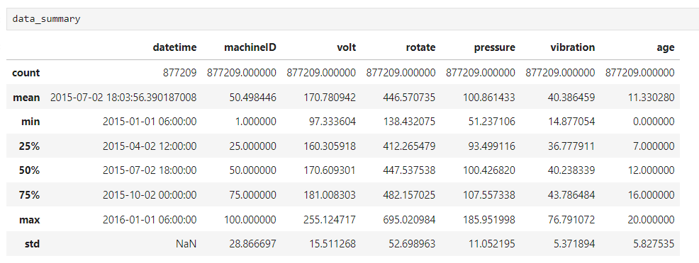
Data Description
Telemetry Data
Additional Data
Voltage measurements
Error logs
Rotation speed data
Failure records
Pressure readings
Maintenance history
Vibration measurements

Slide 5

Data Preparation and Feature Engineering (EDA) 1/3
1
Data Collection
Gather telemetry data, error logs, maintenance logs, and failure logs from various sources.
2
Data Cleaning
Address missing values, remove outliers, and synchronize timestamps across different types of data.
3
Feature Engineering
Compute rolling statistics, create lagged features, and perform categorical encoding on error codes.

Slide 6
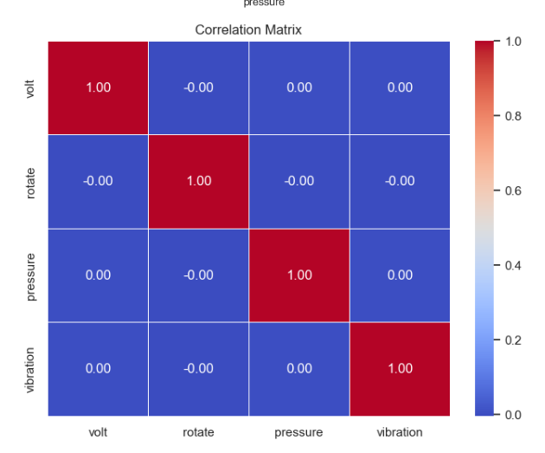
Data Preparation and Feature Engineering (EDA) 2/3
Outlier Analysis: From the continuous variables (volt, rotate, pressure, vibration), we've identified a total of 42,030 outliers, which represents approximately 4.79% of the data.
Actions for Outliers: Given that outliers constitute a small but significant portion of our dataset and can potentially skew the analysis.
Remove Outliers: This is the simplest approach, but we risk losing valuable data, especially if outliers are indicative of actual machine faults or failures.
Cap/Floor Values: We can limit the range of values to within a sensible threshold, effectively reducing the impact of extreme values.
Standardization/Normalization: We'll also standardize the continuous variables, which is crucial for many machine learning algorithms to perform optimally.
Correlation Matrix: The correlation heatmap reveals that the continuous variables (volt, rotate, pressure, vibration) have relatively low correlations with each other, with no values exceeding 0.2 in absolute terms. This indicates that each variable provides unique information without substantial redundancy.

Slide 7
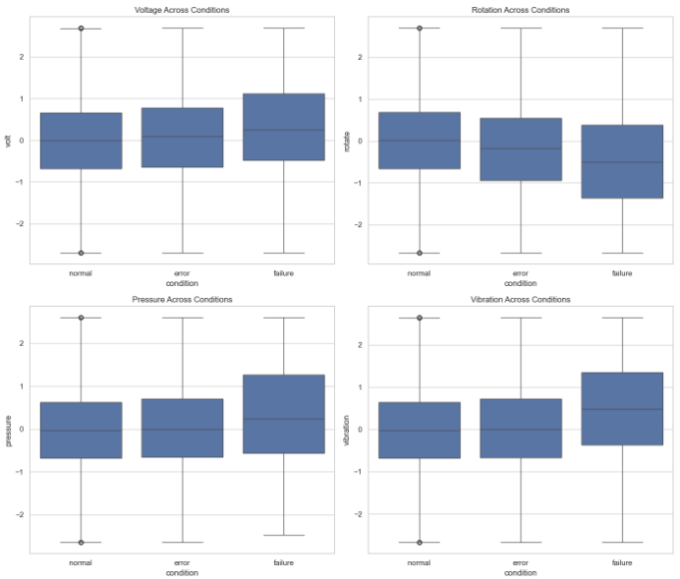
Data Preparation and Feature Engineering (EDA) 3/3
Boxplots Across Conditions: These plots show the distribution of volt, rotate, pressure, and vibration across different machine conditions (normal, error, and failure). There doesn't appear to be significant visible differences between the conditions in the boxplots, suggesting that the variations within these parameters might be subtle and not easily distinguishable just by simple descriptive statistics, this indicate an unbalanced dataset.

Slide 8




Model Development and Evaluation 1/2
Model Selection
Evaluate various machine learning models including Decision Trees, Random Forests, Gradient Boosting Machines, and Neural Networks.
Training and Validation
Split the data into training and validation sets to ensure the models are robust and generalize well.
Performance Evaluation
Use metrics like accuracy, precision, recall, F1-score, and ROC-AUC to assess model performance. Generate ROC curves and Precision-Recall curves for visual evaluation.

Slide 9
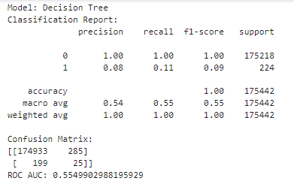
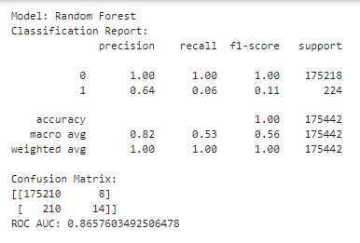
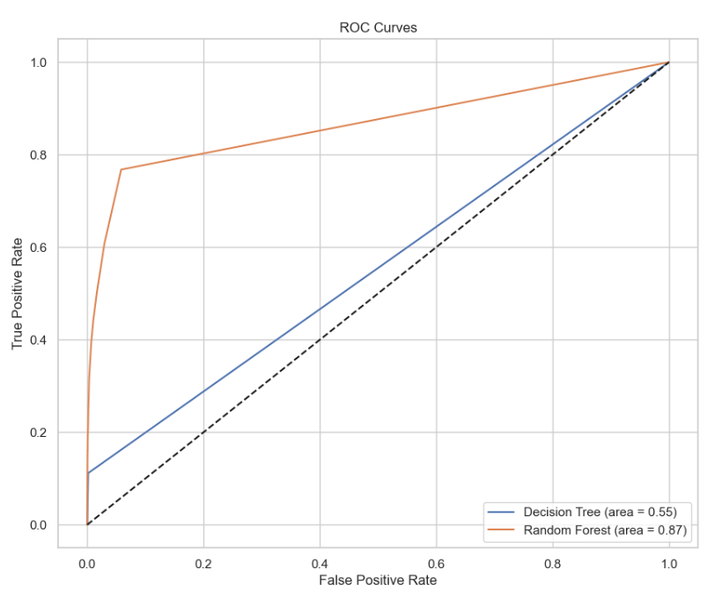
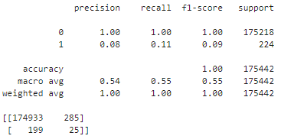
Model Development and Evaluation 2/2

Slide 10
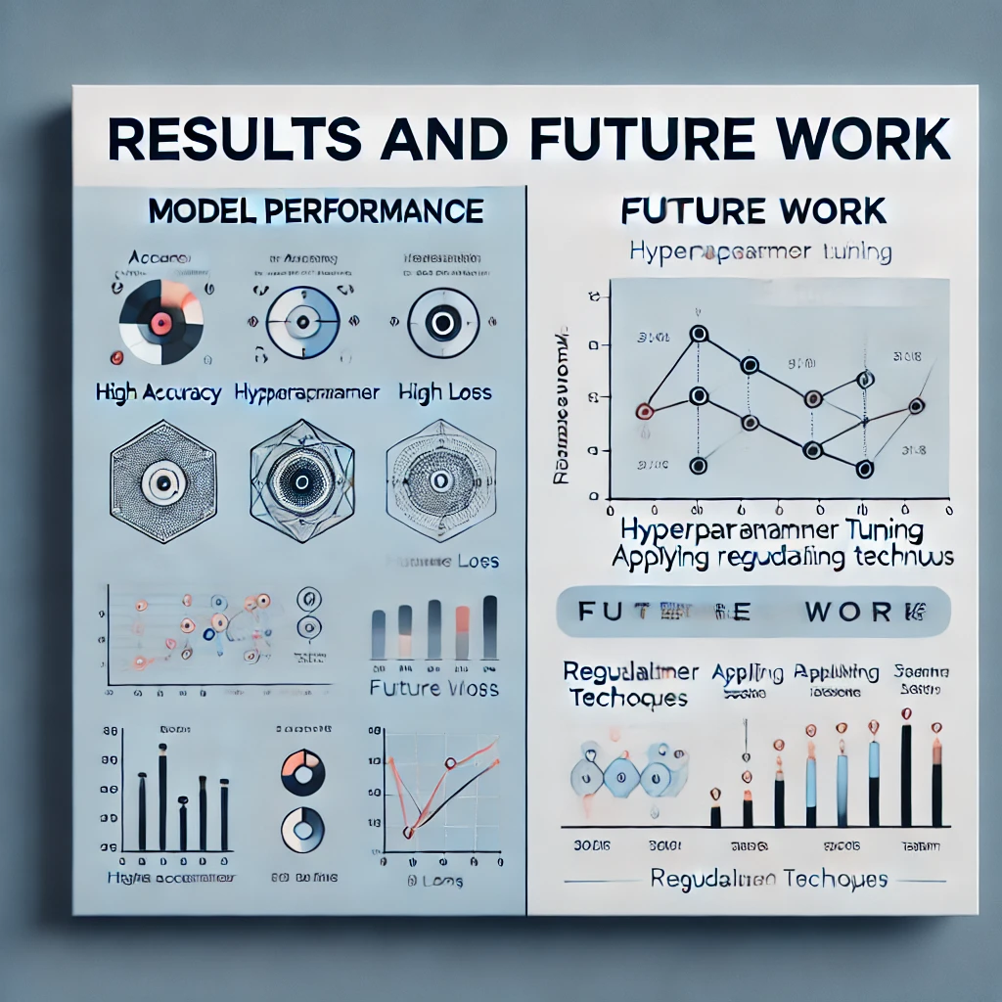
Results and Future Work 1/2
Current Results
The predictive models, particularly the Random Forest model, successfully identified potential failures with high accuracy. The high AUC indicates effectiveness in distinguishing between failure and non-failure states. But the data they need to balanced.
Future Work
Explore advanced models like CNNs and Transformers
Enhance feature engineering techniques
Expand data collection to enrich training datasets

Slide 11
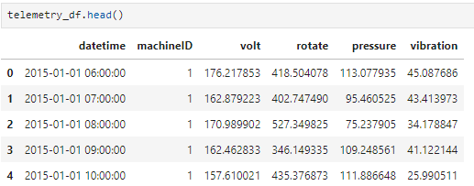
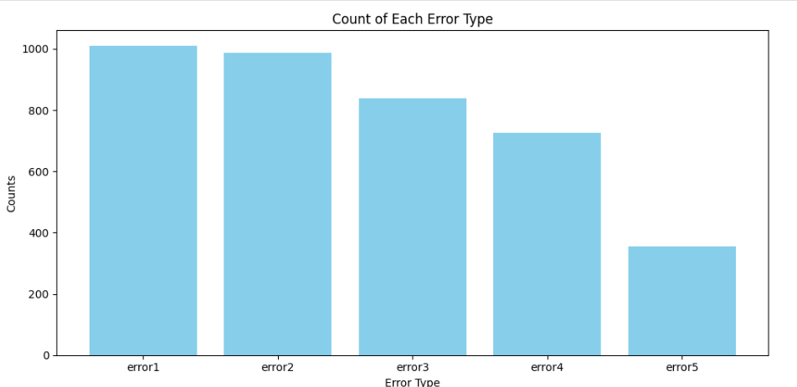
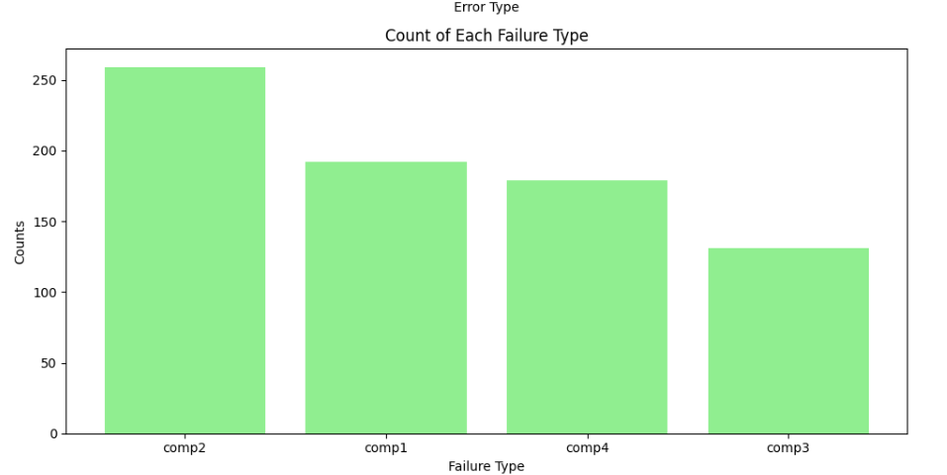
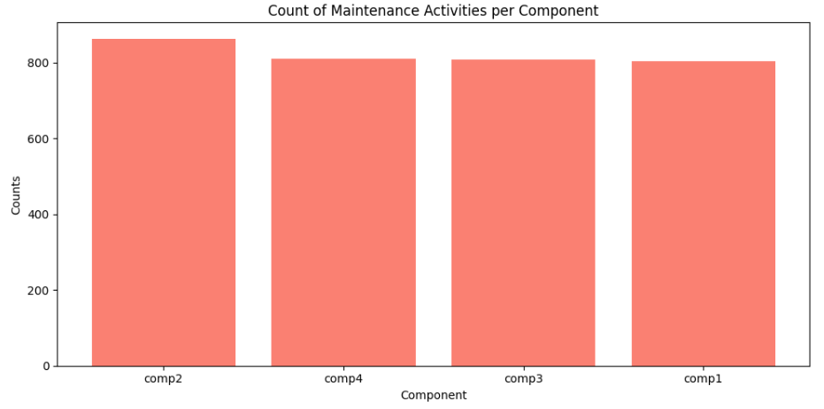
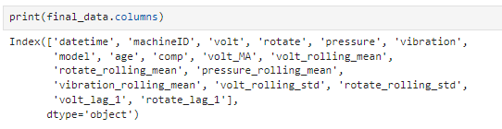
Results and Future Work 2/4
Determine how balanced or imbalanced the dataset is. For that I prefer to reload again the dataset and create a new datasets.
A balanced approach would be to equalize the sample size across all failure types. We could choose to set all categories to the count of the most frequent failure type (259). After I had normalized and standardized the new dataset:

Slide 12
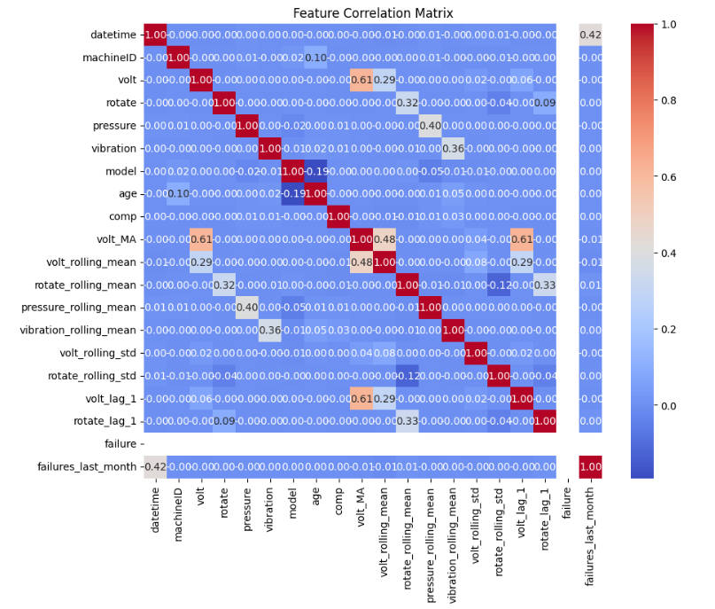
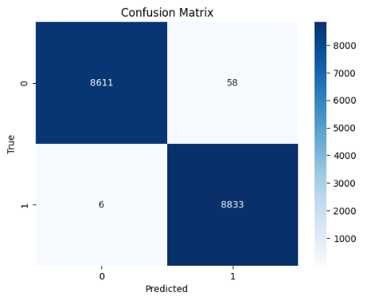
Results and Future Work 3/4
The target variable failure in both the training and testing datasets consists entirely of the class 1 (Failure), indicating that the dataset is not only imbalanced but entirely skewed towards one class. This scenario is quite unique and presents specific challenges:
Model Training Issue: The lack of diversity in the target variable means the model isn't learning to differentiate between classes because no instances of the non-failure class (0) are present.
Practical Implications: Such a dataset might not be realistic unless the data represents a period or scenario where only failures were recorded. It's important to check if this is intentional or a data collection issue.
This dataset is very difficult to balance and try to find a coherent dataframe for predictive analytics, this is also one of the results that came out of this in-depth study for the project.
The quick analysis on the reduced, SMOTE-resampled dataset indicated the following:
Model Performance:
The Random Forest classifier performed well in terms of accuracy, precision, recall, F1 score, and ROC AUC score, suggesting that the model is effective at classifying the target variable in this context. Class Balance:
Applying SMOTE successfully balanced the classes, which was reflected in the improved performance metrics. Feature Relevance:
Feature importance visualization highlighted the key features contributing to the model’s decisions, providing insights into which variables are most predictive of the target class.

Slide 13
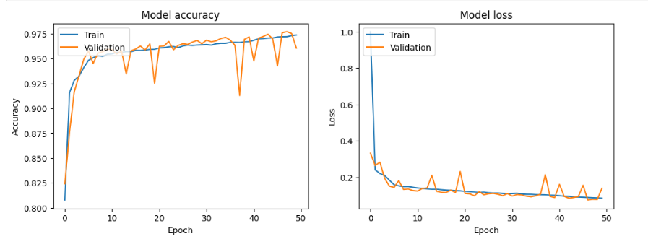
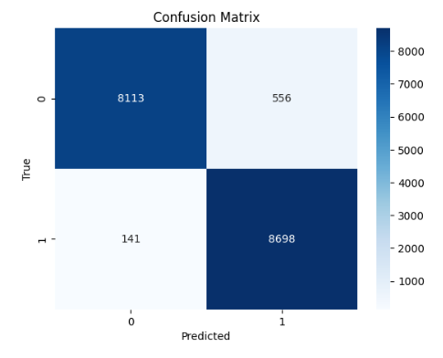
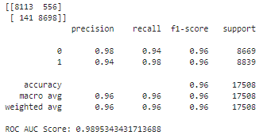
Results and Future Work 4/4
Neural Network Model
After this last balancing of dataset the model performs well with high accuracy and low loss on both the training and validation sets, demonstrating good generalization. There is no significant overfitting, as evidenced by the close tracking of training and validation metrics.

Slide 14

Overall Conclusion:
Balanced Dataset Impact: Following the dataset balancing, the model achieves high accuracy and low loss across both training and validation sets, demonstrating strong generalization without significant overfitting.
Early Training Dynamics: Initially, there is a rapid decrease in both training and validation losses, indicating swift learning early in the training process.
Stable Convergence: Subsequently, losses converge and stabilize at a low level. While both training and validation losses remain low, the validation loss shows slight fluctuations, suggesting some sensitivity to validation data specifics.
Performance Evaluation: The final low values of both losses reflect excellent model performance, characterized by balanced predictive capabilities with minimal false positives and false negatives.
Optimization Opportunities: Minor fluctuations in validation loss suggest potential for further optimization through hyperparameter tuning, regularization techniques, or adjustments to the learning rate schedule.
Deployment Readiness: The model exhibits strong readiness for deployment, pending confirmation that it meets required accuracy and loss thresholds for its intended application.
This summary highlights the model's robust performance, identifies areas for potential improvement, and affirms its readiness for practical deployment.

